Slide 1


2022.2.16
Reported by Xiaoke Li

Slide 2
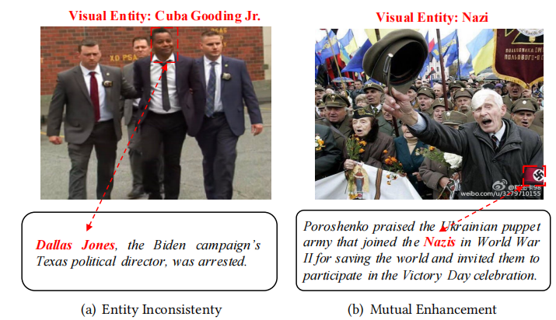
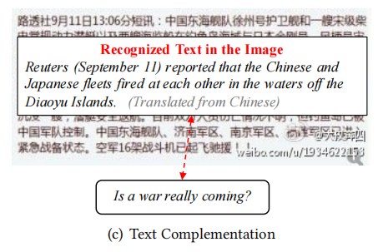
Introduction

Slide 3
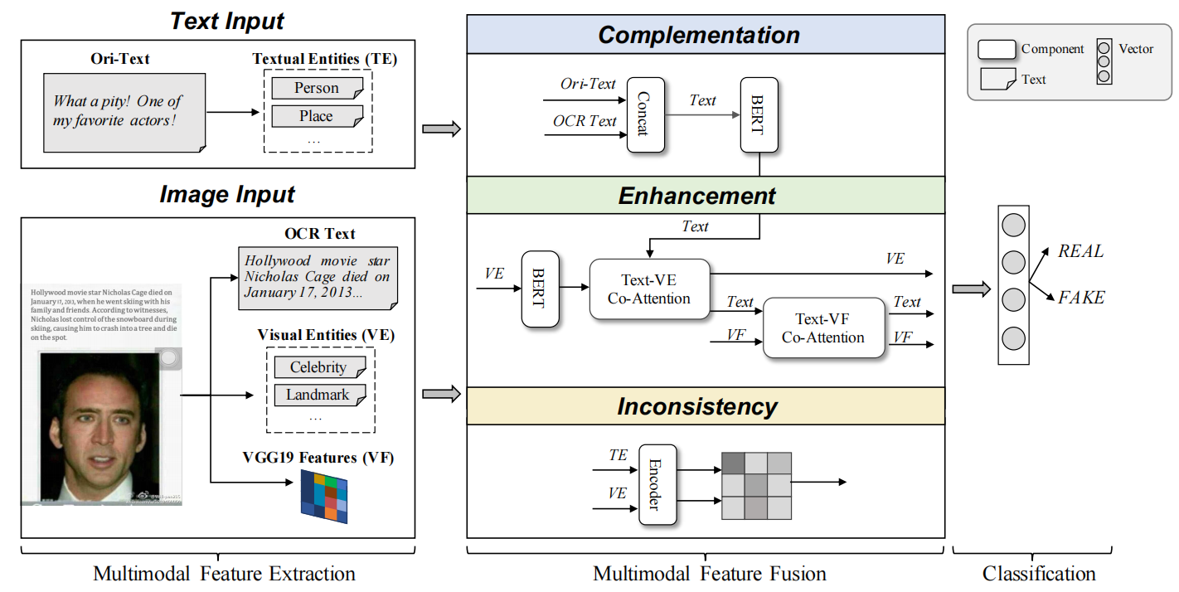
Method

Slide 4
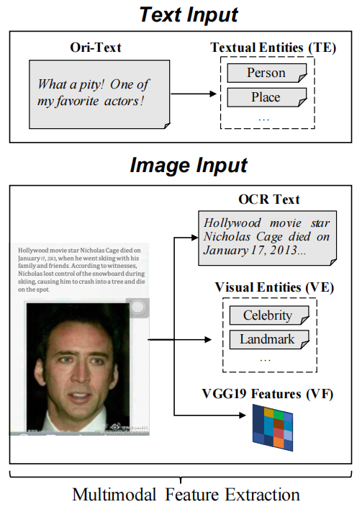

Method
Notes:
te PLC C是词性标注得到的所有名词作为上下文 VE是百度api提取的 特征hv比如图片的分辨率 一般来说清晰度低的图片

Slide 5
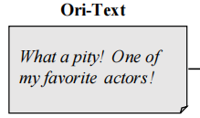
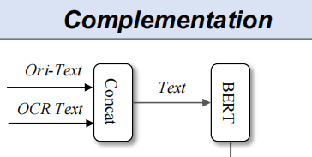
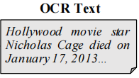

Method

Slide 6
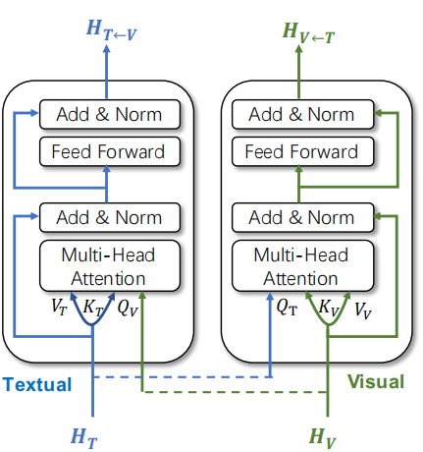



Method

Slide 7
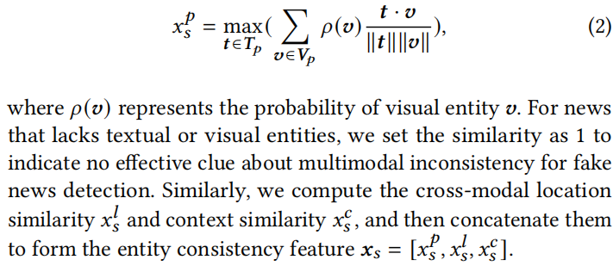
Method

Slide 8
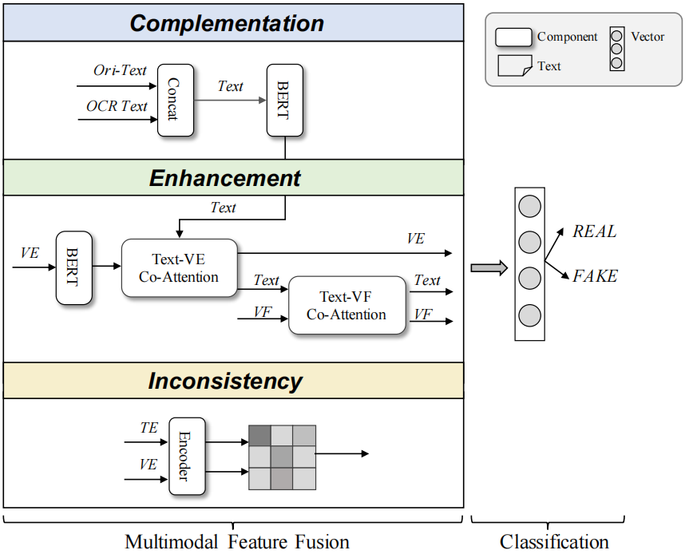
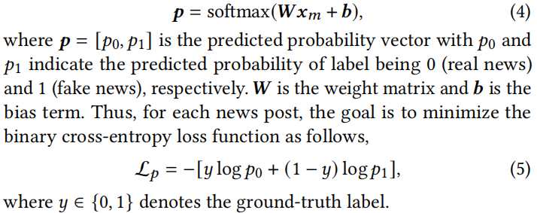
Method

Slide 9
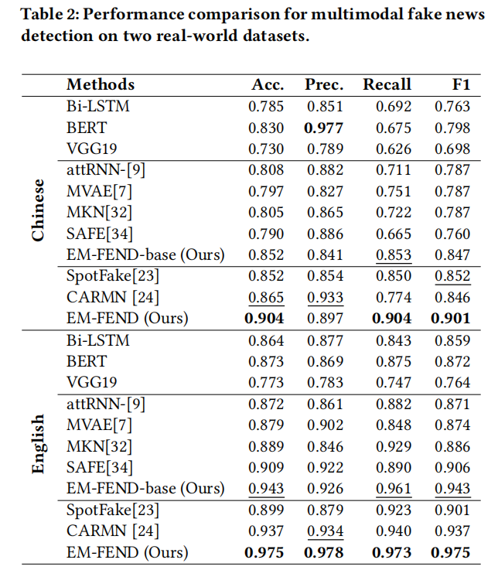
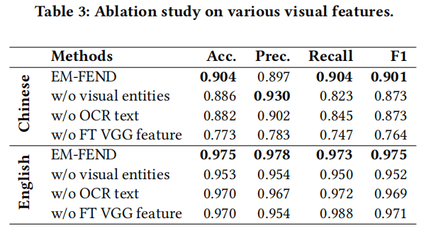
Experiments

Slide 10

Experiments

Slide 11
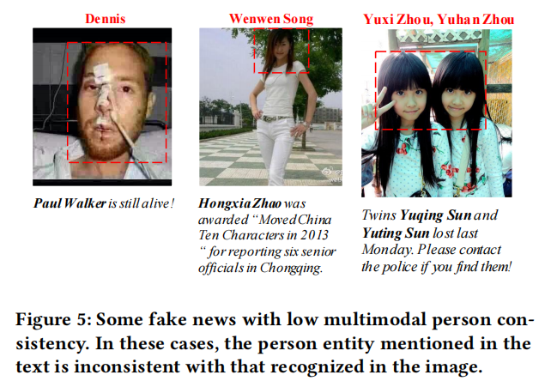
Experiments

Slide 12
Experiments

Slide 13
Thanks

